Slide 1


SMOKING CARS ANALYSER
A Machine Learning bot to help you figuring out whether you're car is good or not.

Slide 2

TEAM
Srinadh Vura
Kamalakar Satapathi
Gayatri Vadaparty

Slide 3
CO2 EMISSION
AN ENVIRONMENTAL ISSUE
Gases that trap heat in the atmosphere are called greenhouse gases.
Carbon dioxide, methane, nitrous oxide, fluorinated gases, etc. are some of the green house gases. These gases causes the climate change, increases the surface temperatures and leads to global warming.
Carbon dioxide is the primary green house gas emitted and accounted for 79% of all green house gases. It enters into the atmosphere through burning fossil fuels (like coal, natural gas and oil), trees, solid wastes and other biological materials.
Deforestation accounts for about 20% of the CO2 increase from human activities.

Slide 4
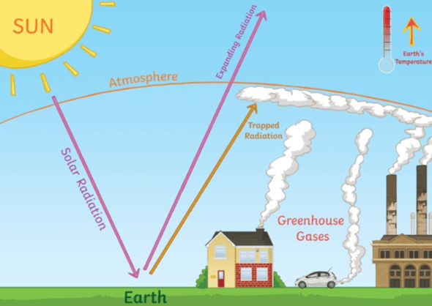

Slide 5
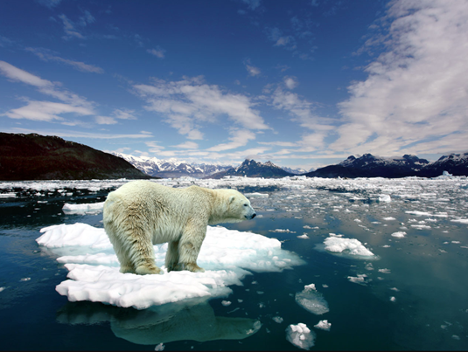
Our personal vehicles are the major cause of carbon emission.
There are over 600 million motor vehicles in the world today.
Burning one gallon of gasoline generates 22 pounds of Carbon Dioxide. When gasoline is burned, the carbon in it is combined with the atmospheric oxygen to form Carbon dioxide.
If present trend continues, the number of cars on Earth will be doubled in next 30 years.
This increases the amount of CO2 in the atmosphere, which results in increase of surface temperatures of the Earth, which in turn leads to melting of polar ice caps, which effects the habitat of polar animals.
Melting of ice caps increases the mean sea level, which can lead to submerging of many coastal areas in the world.
Co2 emission from Vehicles

Slide 6

Can we reduce the carbon emission from vehicles???

Slide 7
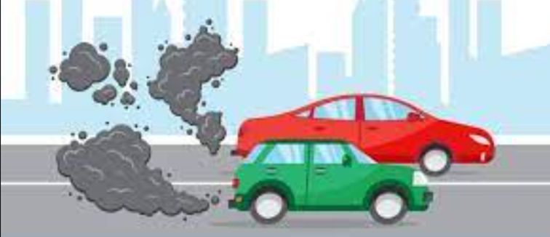
Yes, we can find a way to reduce the carbon emission from vehicles into the atmosphere by minimizing the use of personal vehicles and preferring public transport.
The increase in carbon dioxide content in the atmosphere, increase the surface temperature which cause polar caps to melt and making it hard for polar animals to survive.
We collected the data from an open source website regarding the four wheeler vehicles which are being usedin Canada.
Solution!!!

Slide 8


PROJECT THEME
Why we choose this "Canada dataset"???
As we all know that, Canada is located close to polar regions, so the increase in carbon emissions into the atmosphere can impact the climatic conditions in the Arctic region.
We have analysed the dataset of cars which are being used in Canada.
An approach for predicting the CO2 emissions from four wheeler vehicles(i.e. cars) which are being used in Canada.
The amount of carbon emission from a car mainly depends on the model/type of the car, type of fuel used, mileage of the car and carbon emission per kilometre.
We categorize the cars into two classes:
>>Car is in good state (i.e. carbon emission is less)
>>Car cannot be used further(i.e. carbon emission exceeded its limit.

Slide 9



Project Outline
Steps followed in building our project
Data accumulation
Data
Preprocessing
Choosing and training the algorithm
Testing the model
Analysing the metrics
Why your outlook and attitude are important
Testing the model
Analaysing

Slide 10


METHODOLOGY
>>Data acquistion:
The data was collected from an open source website to build our project.
Our dataset has nearly 7400 records and 14 columns of data regarding the cars which are being used in Canada.
Dataset contains the information of manufacturer of the car, type/model of the car, type of fuel used, mileage and carbon emission per kilometer.
The collected is then processed before the model is trained and tested on it.

Slide 11

>>IMPLEMENTING A MULTIPLE LINEAR REGRESSION MODEL:
For building up the model to estimate the carbon emission from the car, we chosen regression model.
The model is built by training and testing the model on the dataset.
>>TRAINING AND TESTING DATASET:
Training dataset contains the known outputs from where the machine is trained to learn.
Testing dataset is used to test the model, the model predicts the output based on what it learned.
This helps in evaluating the performance of the model, and can take necessary steps to improve its accuracy.
>>TRAINING THE MODEL:
Training a model is simply making it to learn from the resources/inputs and to provide the correct output.
The main aim of training a model is to minimize the loss, and to find the optimal setting of the model to give the accurate results.
>>TESTING THE MODEL:
Testing the model, makes model to predict the output from what it learned. We can evaluate the performance and accuracy of the model.
It helps in making prominent changes in the design of the model to improve its accuracy furtherly.

Slide 12








Resource Page

